Slide 1


Sentiment Analysis
Women’s E-Commerce
Barbara Payne

Slide 2
Sentiment Analysis
Process of detecting positive or negative sentiment in text
Fine grained
Emotion detection
Aspect based

Slide 3
Benefits
Understanding customers
Sorting data at scale
Real time analysis
Consistent criteria

Slide 4
Dataset
https://www.kaggle.com/nicapotato/womens-ecommerce-clothing-reviews
Real reviews
23,486 rows of data
10 variables
Store has been anonymized
Feature variables
Clothing ID
Age
Review Title
Review Text
Rating
Recommended Indicator
Positive Feedback Count
Division Name
Department Name
Class Name

Slide 5
Methods
Exploratory Data Analysis
Sentiment Analysis
Data Analysis

Slide 6
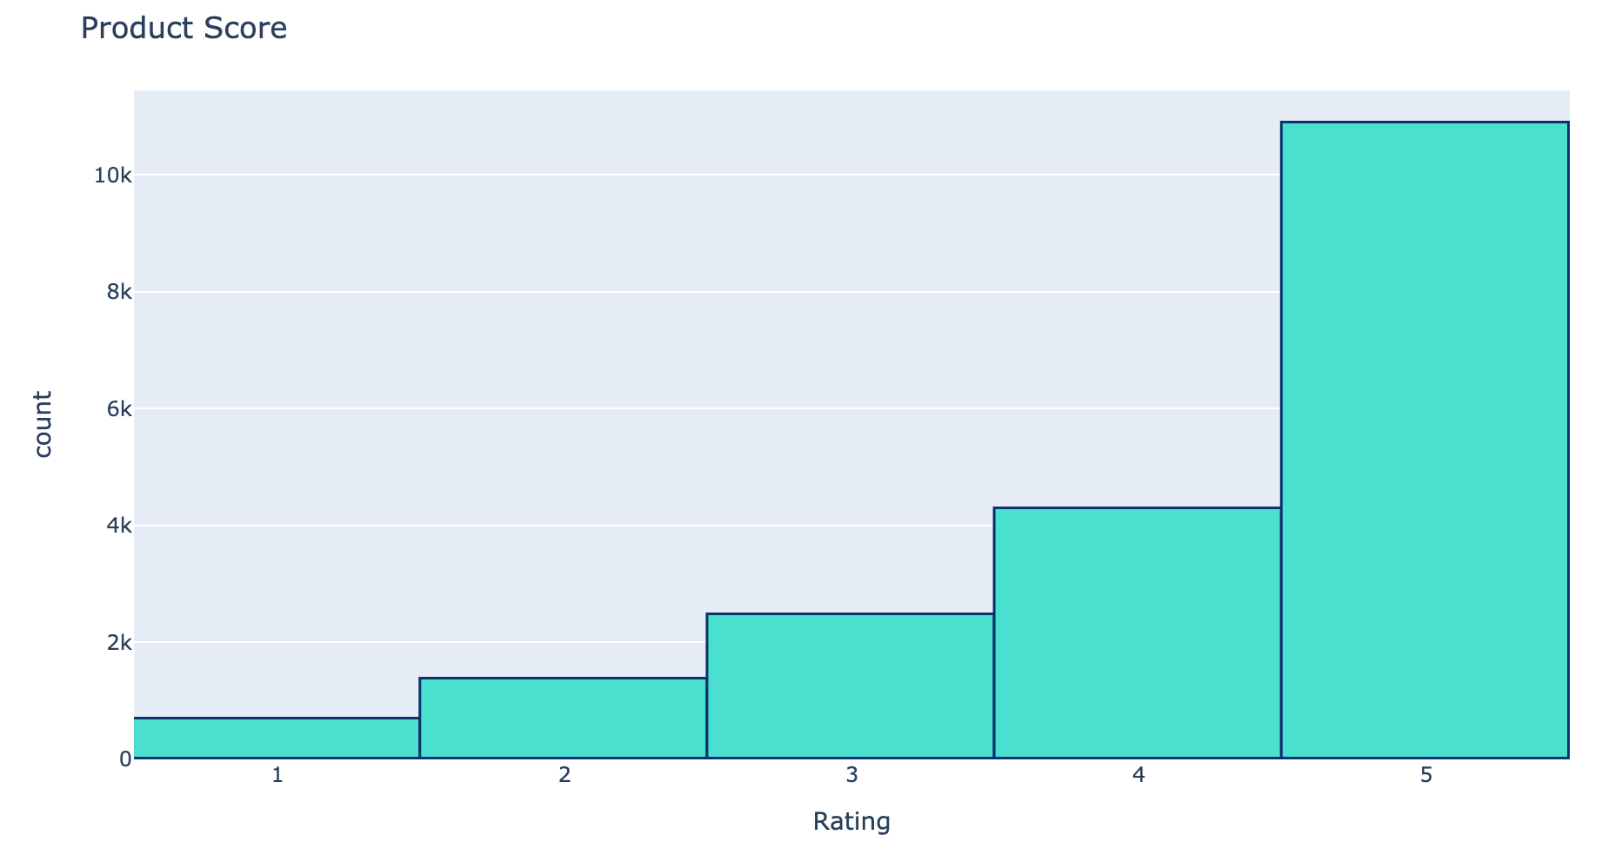
Results – EDA

Slide 7
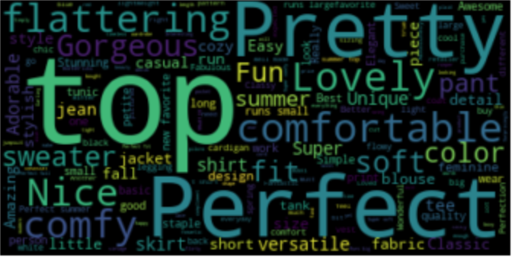
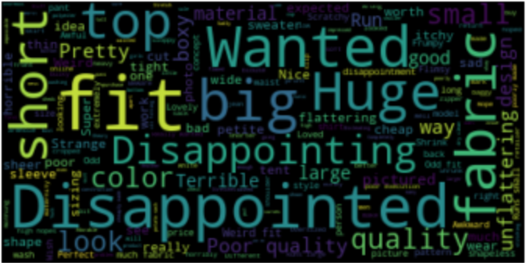
Results – Word Clouds
Positive
Negative

Slide 8
Results – Sentiment Analysis
Removal of punctuation
Removal of stop words
Bag of Words
Stemming
Logistic Regression

Slide 9
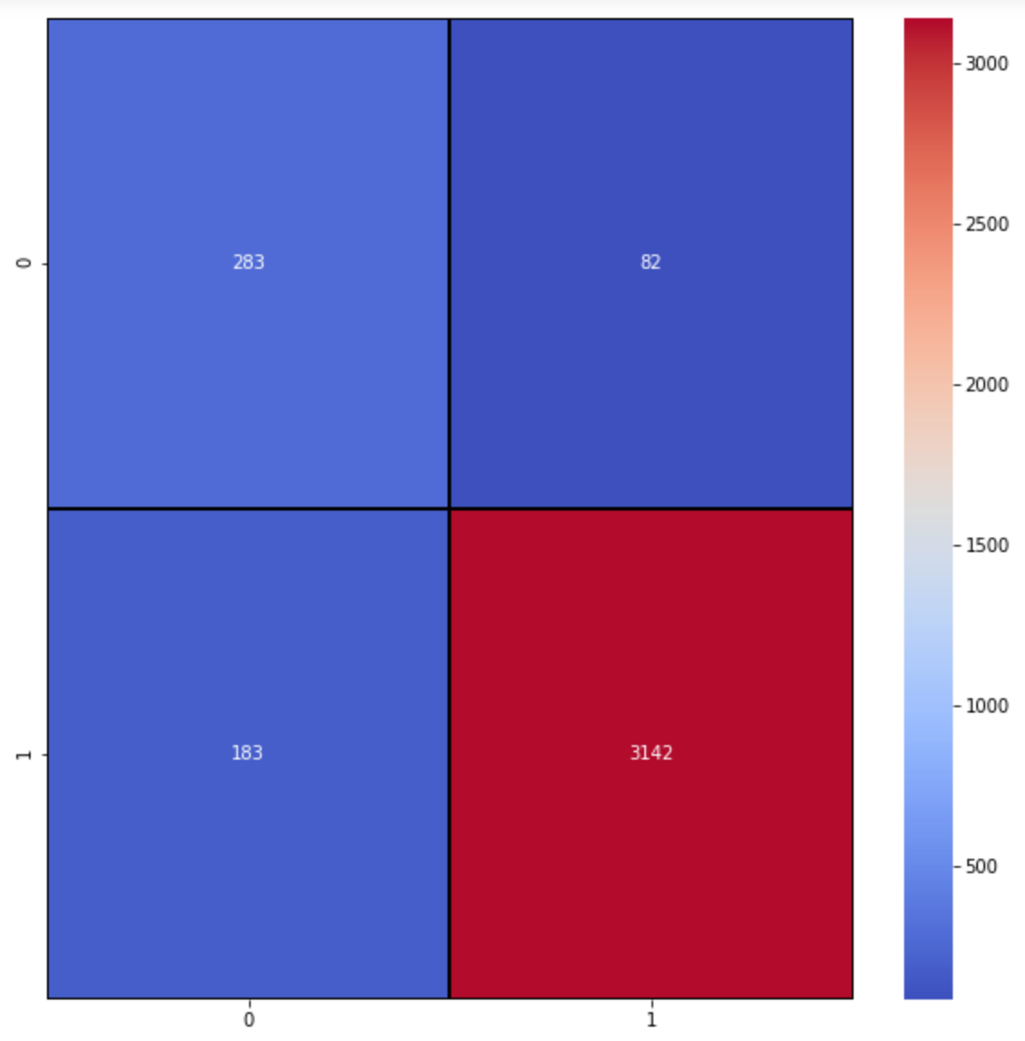
Results – Sentiment Analysis

Slide 10
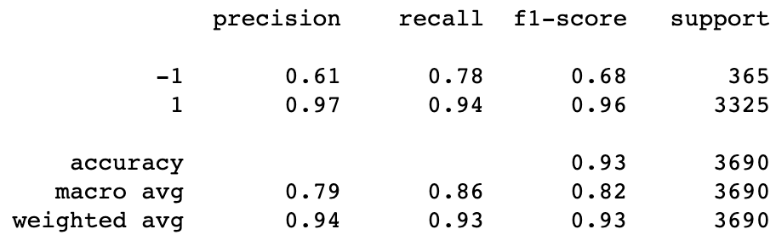
Results – Sentiment Analysis

Slide 11
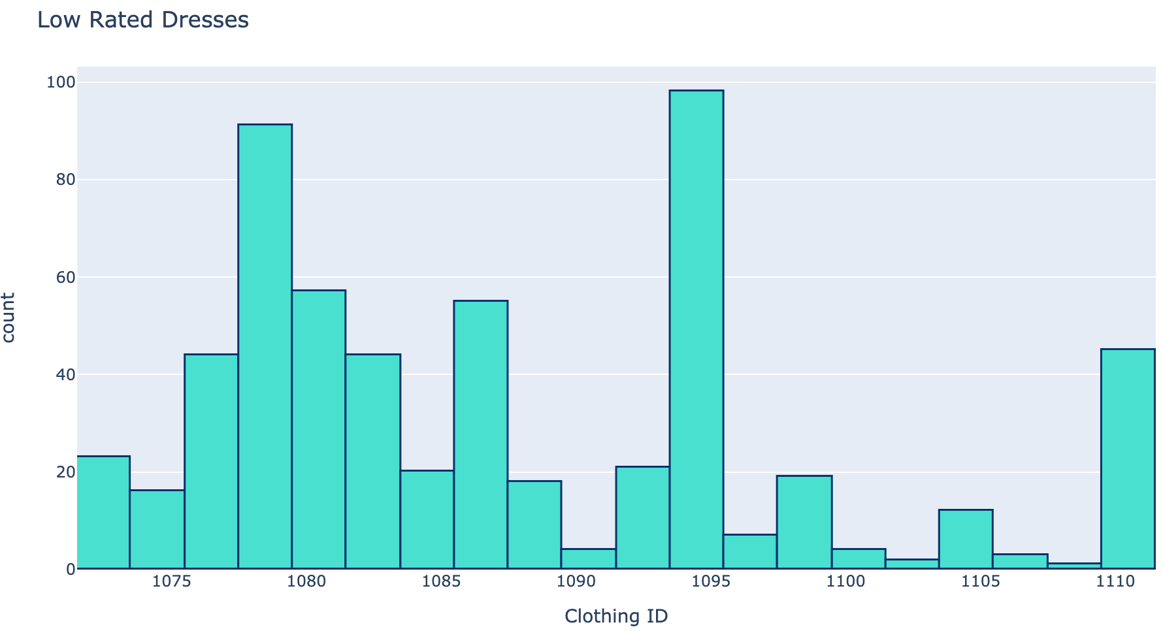
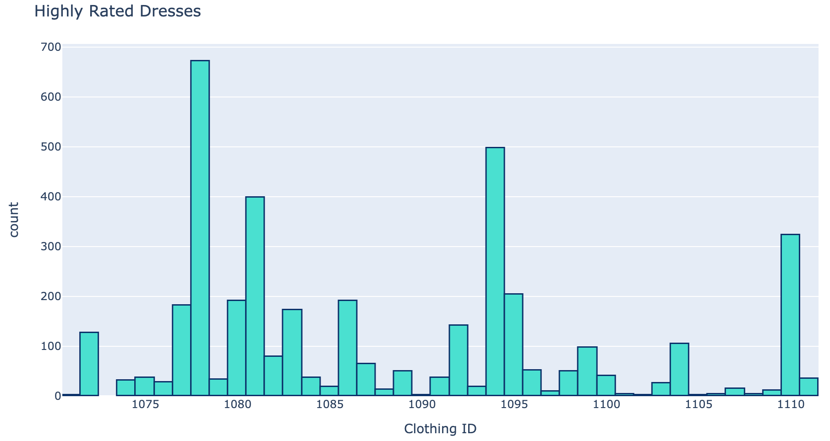
Results – Other Analysis

Slide 12
Conclusion
Sentiment analysis successful
Many benefits in sentiment analysis
Other analysis not successful

Slide 13

Thank you

